Slide 1
Seville, Summer 2025
May 28 – June 27
Notes:
Hello! My Name is Nataliya Marchenko and I am happy to introduce ICISP study abroad program in Seville, Spain during summer 2024 semester. Program dates are May 29 through June 28.

Slide 2
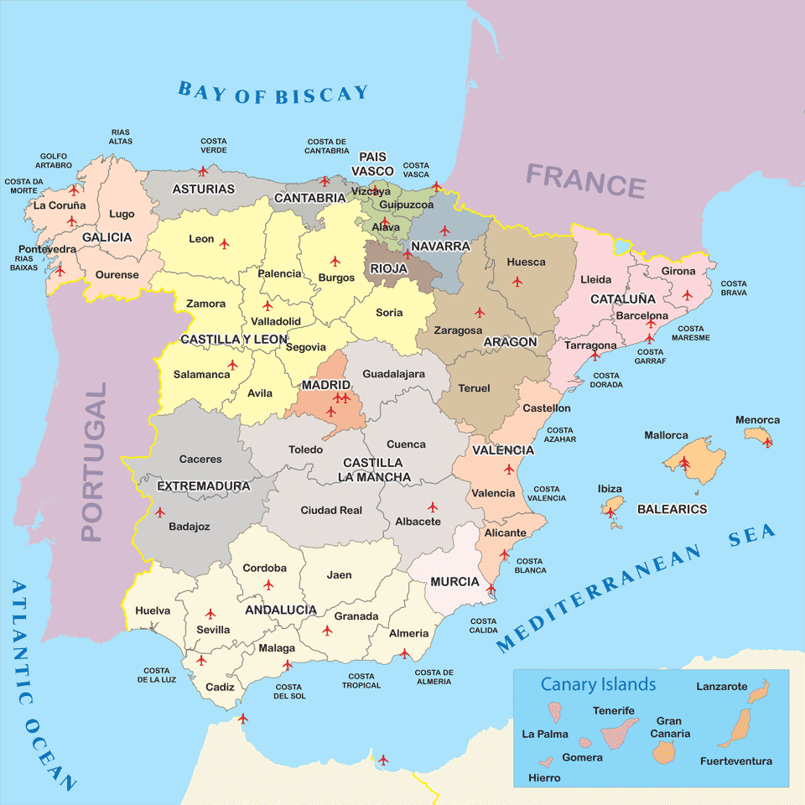
Andalusia
Notes:
Andalusia most populous and the second-largest autonomous region in Spain and Seville is its capital city. It is also a hottest and driest region in Spain, home to the hottest city in Europe – Cordoba.

Slide 3
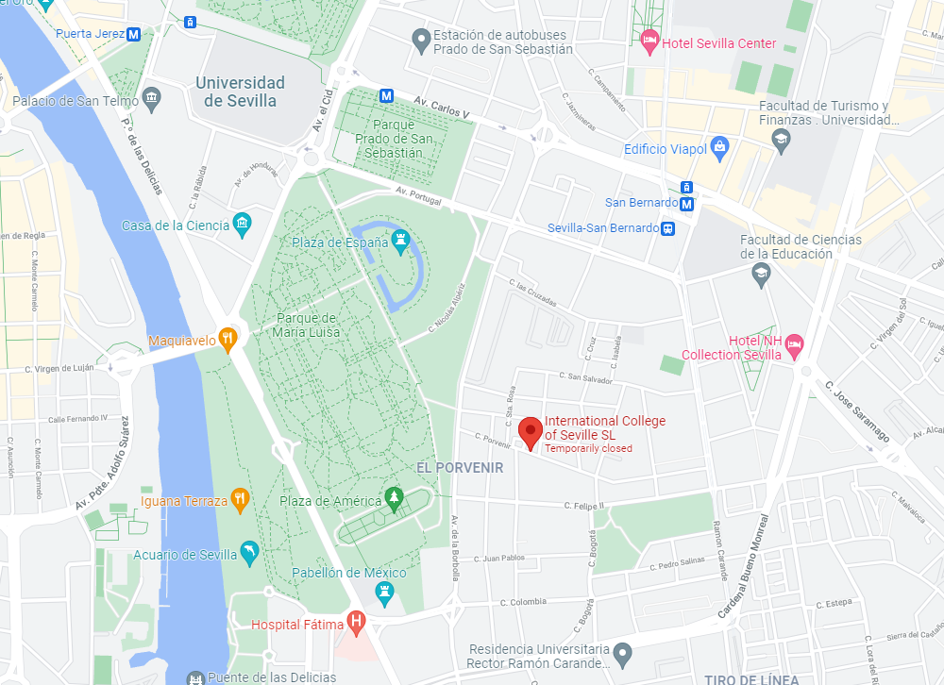
International College of Seville
Notes:
International College of Seville is located in quite residential Porvenir neighborhood near Maria Luisa park, 10 min walk to the famous Plaza de Espania, 15 min walk to the University of Seville, and 30 min to the historical center of the city.

Slide 4
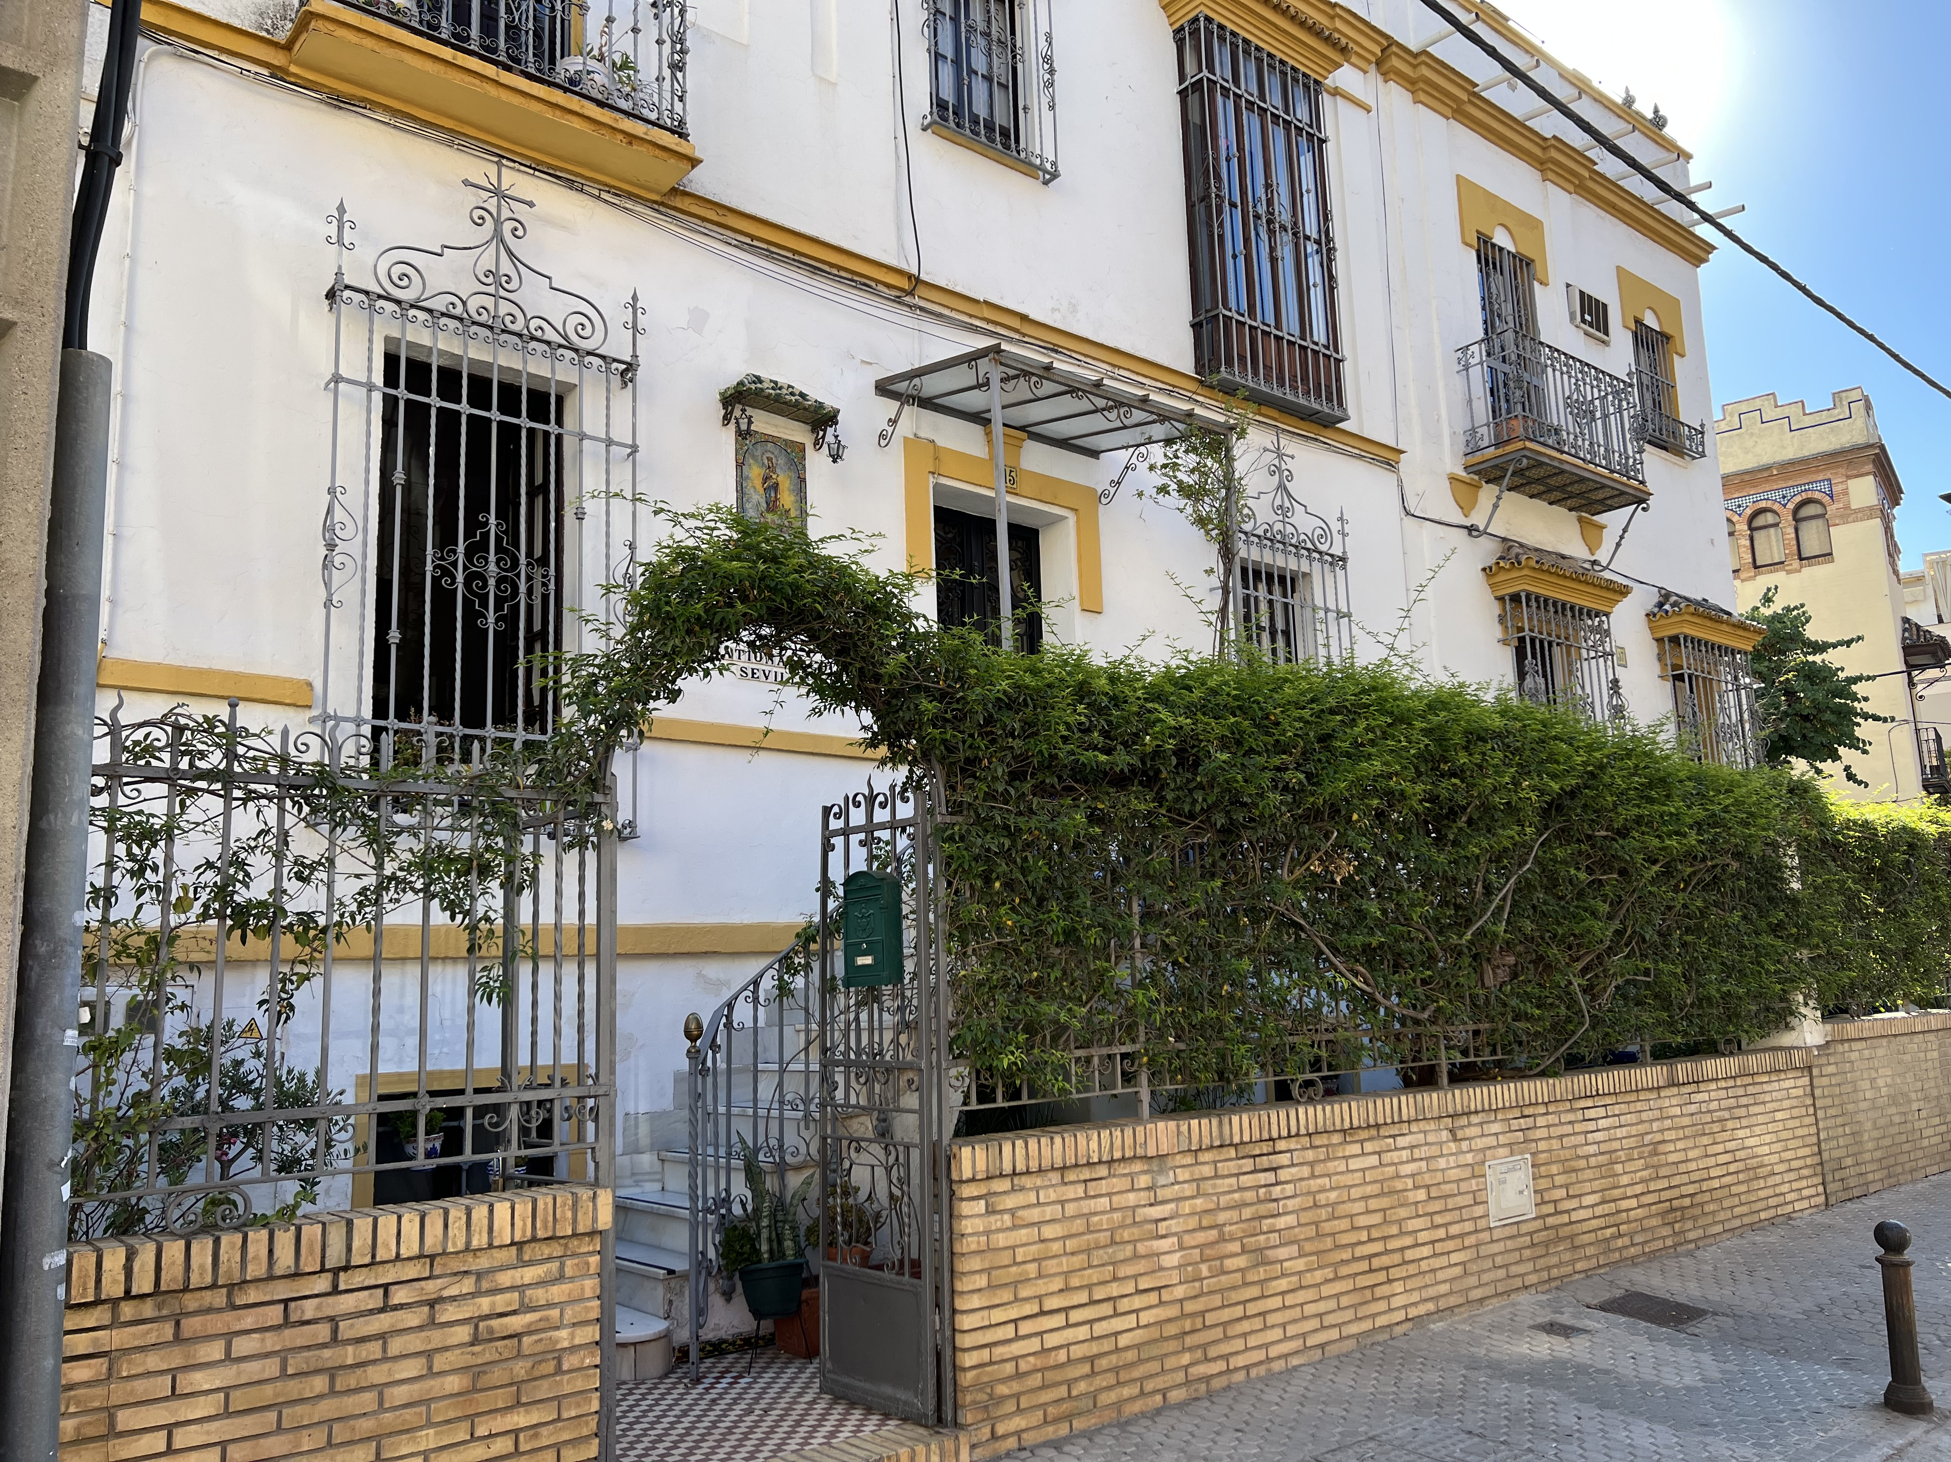
International College of Seville (ICS) (cont.)
Small school – 50 – 80 students per semester
All US students from Midwest, Florida, Hawaii
Very “homey” atmosphere
ICS website is a good source of information:
Academic calendar
Schedule of field trips and city tours
Course syllabi
Class schedule
Information about Spanish culture & society

Slide 5
Admission Requirements
completion of at least 12 hours of college-level coursework;
completion of English Composition or its equivalent with a B or better;
a cumulative college earned grade point average of 2.5/4.0 or higher;
two recommendation letters one of which must be from a faculty member;
approval and recommendation of applicant’s campus ICISP representative.

Slide 6
Schedule
Classes Monday through Friday:
9 a.m. until 11:00 a.m. – Spanish language classes (all levels)
11:30 a.m. until 1:30 p.m. – Culture and Society of Spain
Exams every 2 weeks (mid-terms and finals)
Siesta – 2 – 5 p.m.
Afternoons and evenings – cultural activities in Seville
Weekends – mandatory day and multi-day trips
Students have 1 free weekend

Slide 7
Housing and Cost
Homestay only (no dorms) in a single or shared room with shared bathroom. Included:
laundry and linens
21 meals per week, including the option to request a “meal to go” when necessary
Program cost $4,795:
includes ICS tuition, housing, meals, cultural activities in Seville and trips to Cordoba and Morocco
airfare, passport and immigration fees, personal expenses not included.

Slide 8
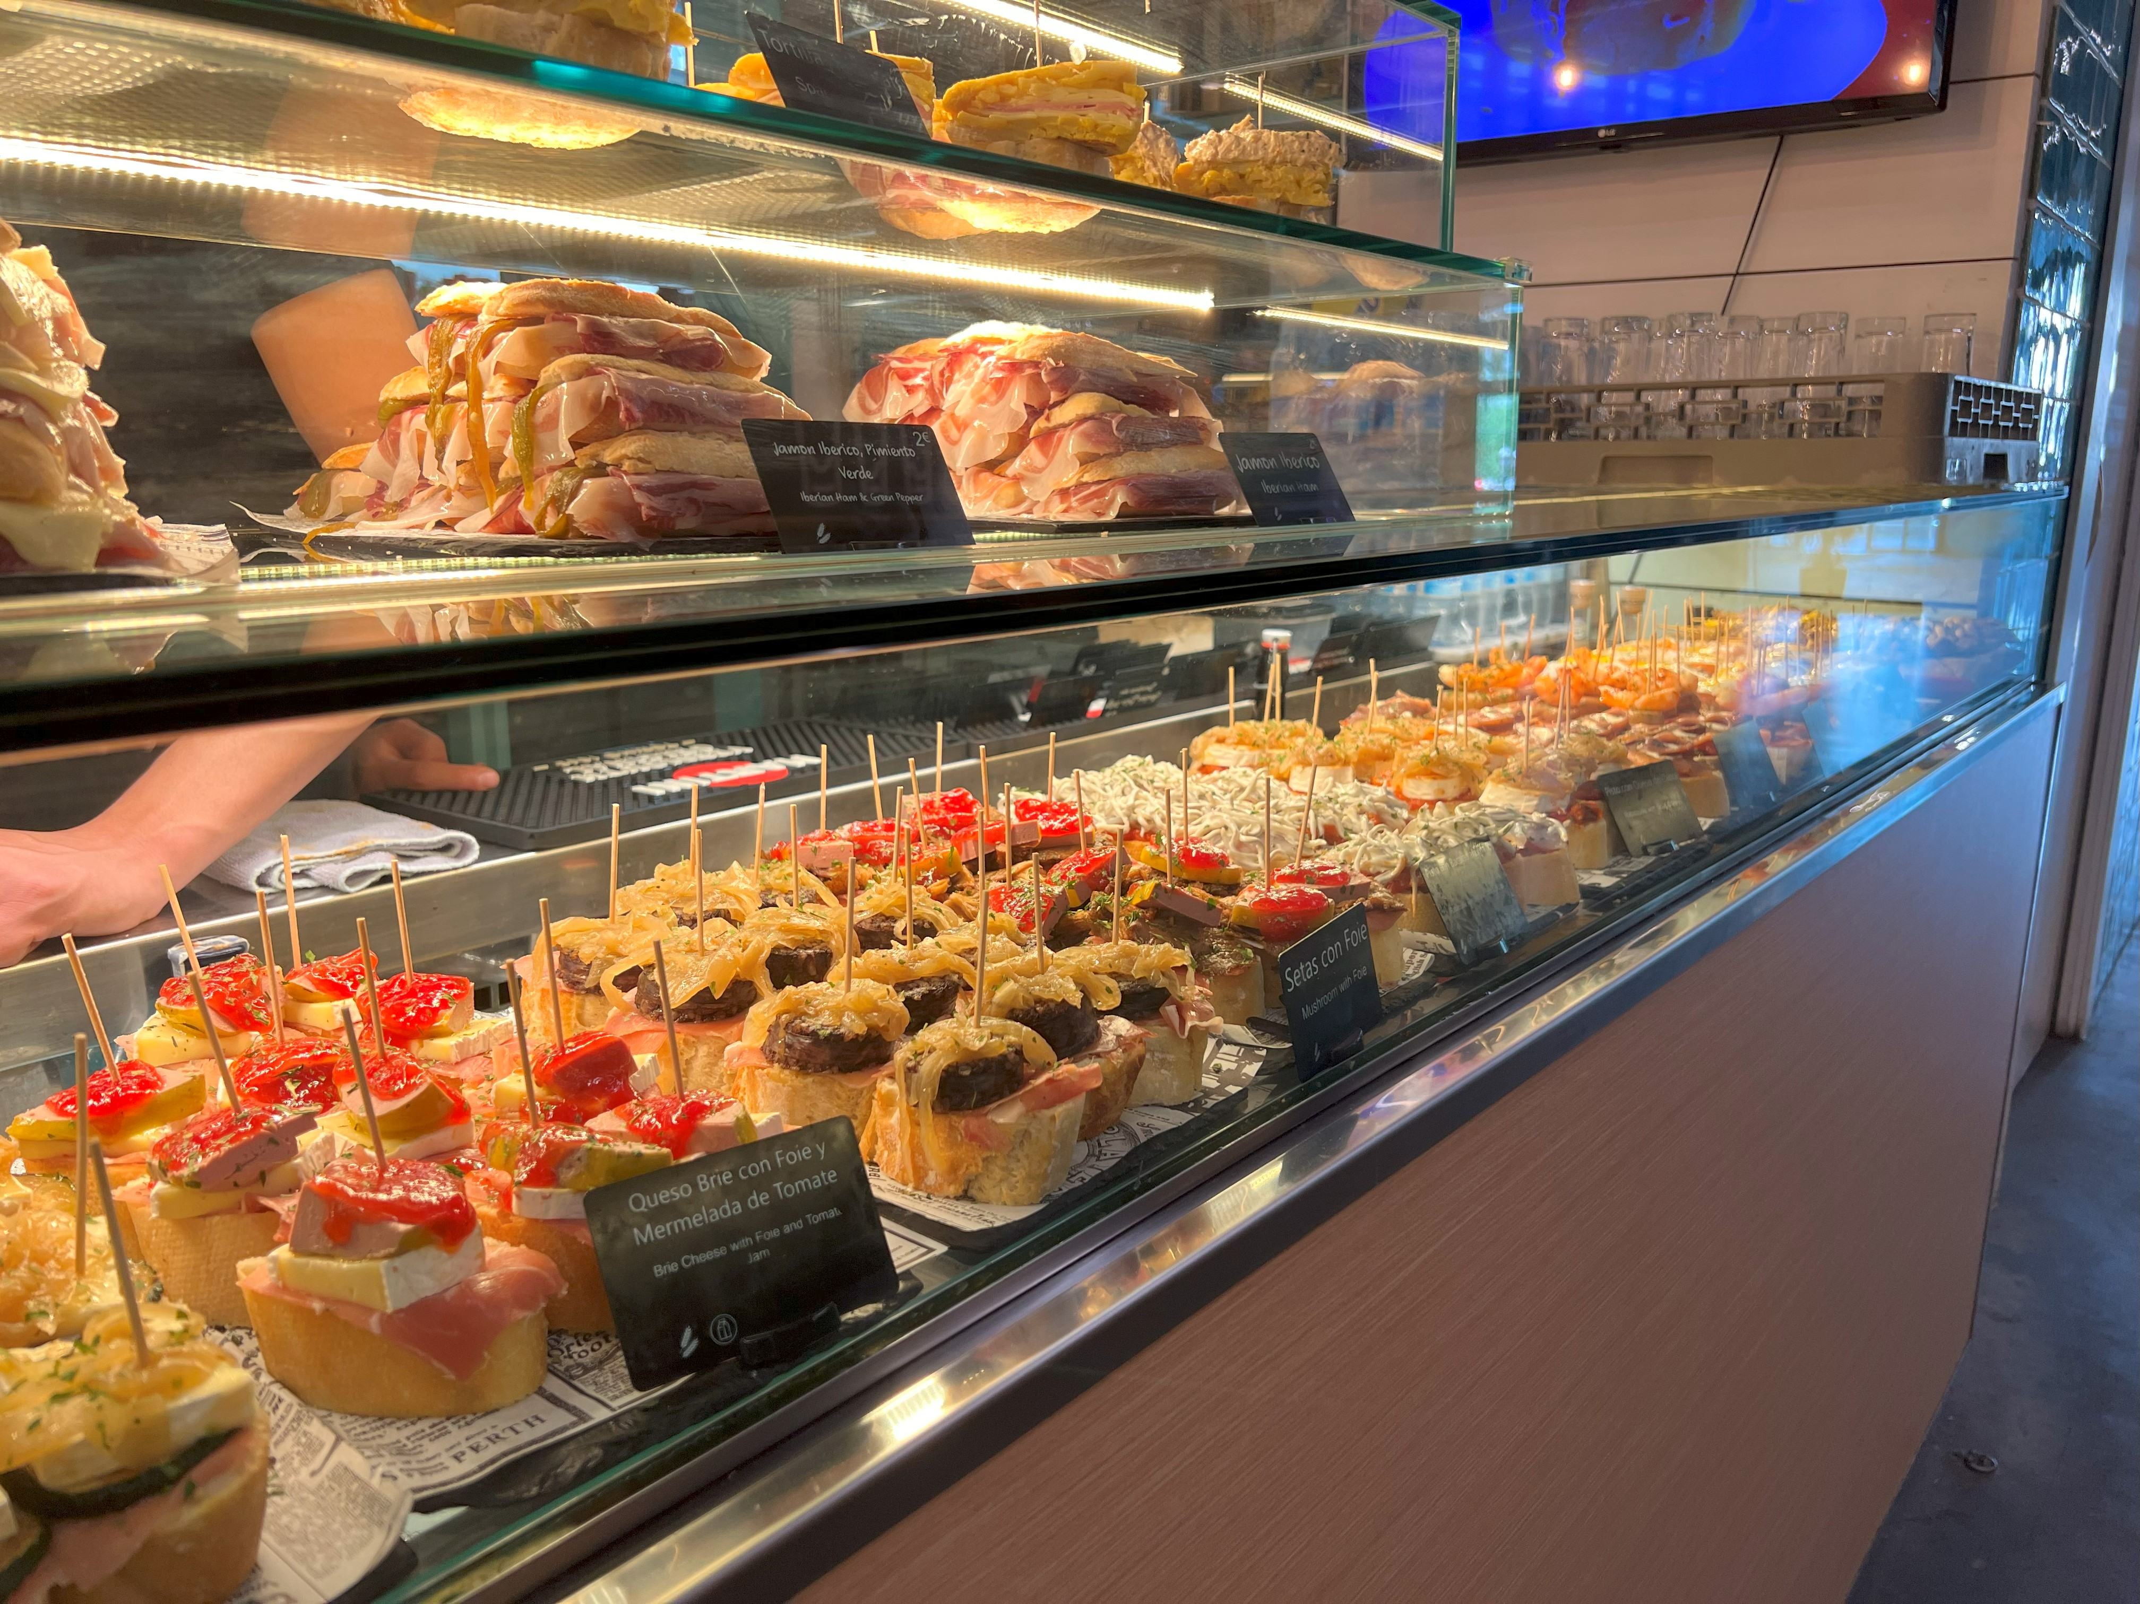
Food in Seville
7-8 am – early breakfast of toast and a drink (coffee, tea, juice, milk)
11 – 11:30 am – second breakfast of a sandwich and a drink
2 - 3 pm – lunch (largest and the most important meal of the day)
after 8 pm – dinner (often tapas)

Slide 9
Questions? Contact
ICISP Seville, Spain Program Coordinator
Dr. Nataliya Marchenko
Joliet Junior College
Email: nmarchen@jjc.edu
Phone: (815)280-2214

