Slide 1
Patient Care Technician
Orientation

Slide 2
What is a Patient Care Technician (PCT)?
Patient care technicians (PCTs) are invaluable healthcare team members who provide primary care and comfort alongside doctors, nurses, and other healthcare providers. PCTs perform a wide range of activities such as drawing blood, administering electrocardiogram assessments and measuring/monitoring vital signs.
Working as a PCT is a great stepping stone into nursing as well as a wonderful way to explore health careers.

Slide 3
Where do I start?
Complete the Patient Care Technician orientation (online or in-person).
Be at least 16 years of age for Nursing Assistant 101 and HEAL 100. Be at least 18 years of age for NA 120/123 Phlebotomy and NA 122/125 Electrocardiography courses.
Speak and understand the English language. Have a valid Social Security number.
Be a registered JJC student.
Register online, by phone (815-280-2497), or in person (Registration, A-Building, 1st floor Main Campus)
Apply to JJC. Click the following link to apply: Workday

Slide 4
PCT Expenses
On the JJC PCT webpage, click on the “Expense List” for current tuition, fees, and other expenses for the course.
The NU 425 Program is eligible for IL MAP Grant funding. Please visit the Financial Aid Department for more detailed information.

Slide 5
Financial Assistance
Workforce Development of Will County: 815- 727-4444
Will County Center for Community Concerns: 815-722-0722
Grundy Co Workforce: 815-942-0566
Center for Academic Success in Healthcare (CASH): 815-280-2795, Main Campus, U2012

Slide 6
Refund and Drop Dates
Be sure to check your schedule for the refund and drop dates.
The refund date for NA 101/120/122/123/125 and HEAL 100 is within the first 10 calendar days of the beginning of the semester.
Drop after refund day: withdraw by processing an add/drop form during regular office hours through the Registration Office.
Students can have only one excused absence for each course.

Slide 7
Special Accommodations
If you have a documented disability under the Americans with Disabilities Act (ADA) and Section 504 of the Rehabilitation Act, please contact the Disability Services Office at JJC well in advance of your first day of class.
Share your accommodation letter with your instructor to receive your accommodations in the course.
Disability Services Office: 815-280-2613.

Slide 8
What classes do I need take?
Patient Care Technician Certificate of Completion:
HEAL 100 Intro to Healthcare Careers 3.0
NA 101 Certified Nurse Assistant Training 6.0
NA 120 Basic Phlebotomy Technician 3.0
NA 122 Basic Electrocardiography Technician 3.0
NA 123 Basic Phlebotomy Technician Practicum 2.0
NA 125 Basic Electrocardiography Technician Practicum 1.0
Total Required Credit Hours = 18.0

Slide 9
What order should I complete my classes?
Semester 1:
HEAL 100 Intro to Healthcare Careers 3.0
NA 101 Certified Nurse Assistant Training 6.0
Semester 2:
NA 120 Basic Phlebotomy Technician 3.0
NA 122 Basic Electrocardiography Technician 3.0
NA 123 Basic Phlebotomy Technician Practicum 2.0
NA 125 Basic Electrocardiography Technician Practicum 1.0

Slide 10
What will I learn in HEAL 100 and NA 101?
Heal100 Introduction to Health Careers is learning about all the different professions in the health/medical field. It’s a great place to see what careers are available in healthcare and what you may be interested in. This class is 100% online.
NA 101 is Certified Nursing Assistant course, this is a 6 credit hour class that includes theory or classwork, laboratory or skills practice, and clinical or hands-on patient care. This is a face-to-face class that will lead to CNA certification at the end of successful course completion. Here is the link to the information on NA 101: NA 101 Orientation

Slide 11
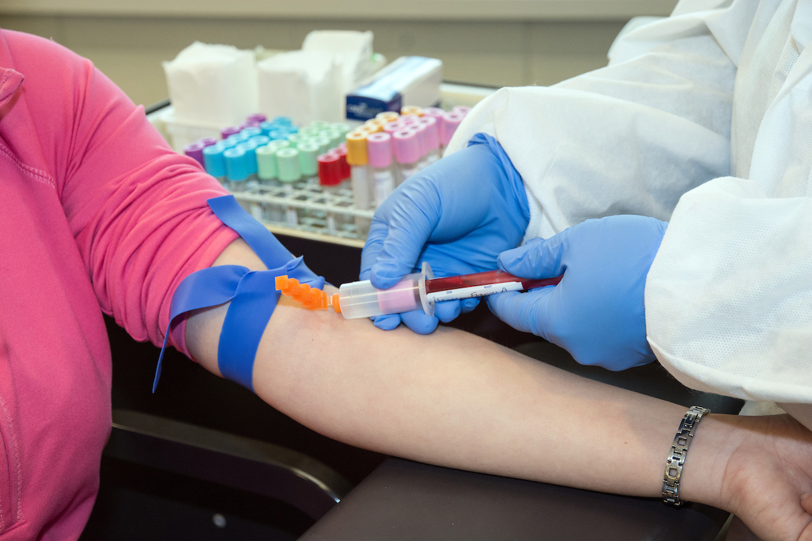
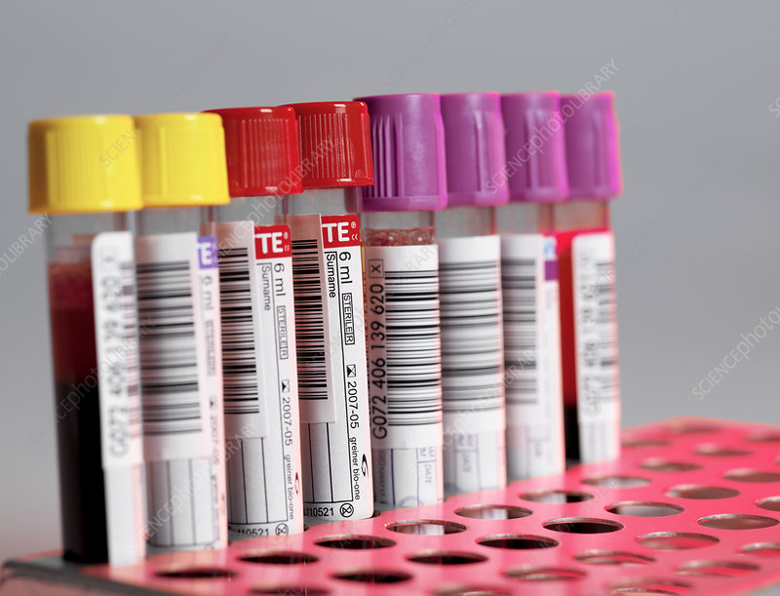
What will I learn in Phlebotomy?
In NA 120/123 Phlebotomy, you will learn how to draw blood, label specimens, obtain other laboratory specimens such as blood glucose levels, urine, stool, sputum and many more body samples. The first 8 weeks (NA 120) is in classroom/online/laboratory environment. The second 8 weeks (NA 123) is an assigned clinical site with a preceptor (nurse, laboratory technician, phlebotomist) at a hospital, laboratory draw center, or other clinical site.

Slide 12
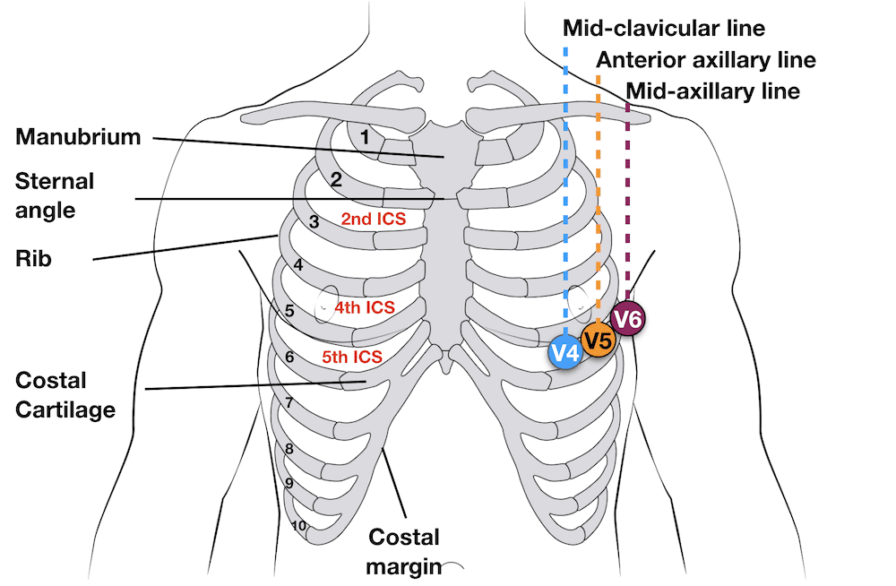
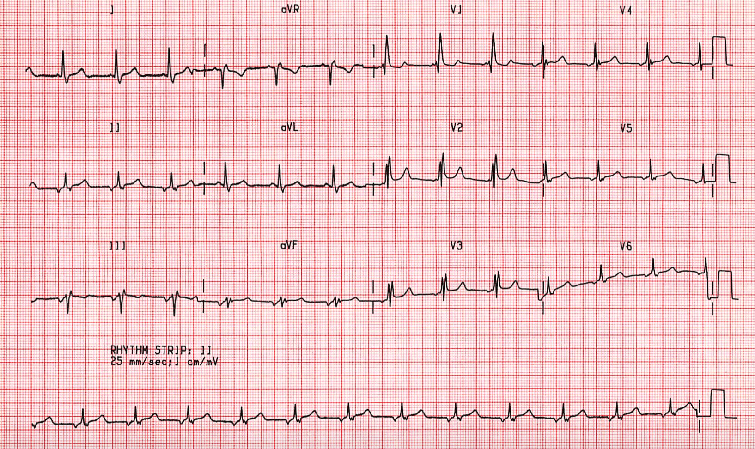
What will I learn in Electrocardiography?
In NA 122/125 Electrocardiography, you will learn how to use an ECG or EKG machine, interpret cardiac rhythms, and monitor for lethal cardiac rhythms. The first 8 weeks (NA 122) is in classroom/online/laboratory environment. The second 8 weeks (NA 125) is an assigned clinical site with a preceptor (nurse, ECG technician) at a hospital or other clinical site.

Slide 13
Course Requirements
You must pass all theory components to move on to the clinical rotation.
Maintain an 80% average on the 10 quizzes to take the preclinical exam; otherwise, the student must withdraw.
Acquire an 80% on the pre-clinical exam to advance to clinical. Otherwise, the student must withdraw.
Submit all healthcare requirements into ViewPoint to take the pre-clinical exam.
Pass the clinical rotation and acquire an 80% on the clinical exam to complete the course.

Slide 14
Attendance
Attendance is required for all scheduled classes, including the first day. Students who are absent on the first day of class will need to drop the course without a refund.
The first day of class is mandatory.
In the event of an emergency, students are allowed one absence, and they are to contact the Office of Student Rights and Responsibilities (OSRR) for documentation.
The instructor must be notified, and missed time must be made up in another class within a week of the original absence. Make-up time does not erase the absence.

Slide 15
TO AVOID PROBLEMS WITH ATTENDANCE:
Arrange for back-up childcare.
Schedule work and other commitments around class time.
Have reliable transportation.
Take care of yourself!

Slide 16
TO AVOID PROBLEMS WITH PARTICIPATION:
Check your JJC email several times per day.
Read all Canvas Announcements posted.
Communicate with your instructor frequently via email, text, or phone.
Read the instructions carefully in the Orientation Module.
Start compiling your health requirements early.

Slide 17
Tardies
Students are expected to arrive at the scheduled start time for each class session (including lab and clinical) and return on time after breaks.
Frequent tardies will affect the final grade and may lead to dismissal from the course.

Slide 18
First Day of Class
Bring all required books (available in our JJC bookstore).
The instructor will review health requirements and the course syllabus.
Uniform is not required on the first day of class.

Slide 19
DRESS CODE/UNIFORM POLICY:
Students should come to class, lab, and clinical dressed in uniform.
The PCT Uniform is a Ciel Blue scrub top, black uniform pants, white shoes, and white socks. No clogs. No Crocs. No shoes with open toes and open heels.

Slide 20
Supplies:
JJC student ID.
Gait belts can be purchased at our bookstore.
Blood pressure cuff/stethoscope kit can be purchased at our bookstore.
Watch with a second hand. No smart watches are allowed.

Slide 21
Health Requirements
Nursing assistant courses (NA 101, NA 120/123, NA 122/125) students must use the NA 101 Student Health packet forms to upload all health requirements in ViewPoint.
ViewPoint is a required screening service. Students must purchase ViewPoint to set up an account for $20 and a 10-panel urine drug screen for $40 and background check for $40. Total = $100
Students must fully participate in all course activities without restrictions. The course involves physical activities such as standing for long periods of time, lifting, turning, and transferring.

Slide 22
Health Requirements cont.
Physical Examination
10-Panel Urine Drug Screen
Proof of Immunity – MMRV
Hep-B
Tdap
Flu Vaccination (Fall and Spring ONLY)
Personal Health Insurance
Completion of Hospital and Facility Orientation Packets (for specific clinical sites)

Slide 23
2-Step Tuberculin Skin Test
All students must provide documentation of a 2-step TB test, which checks for exposure to TB:
Step 1: test placed (1st office visit).
Test 1 read within 48-72 hours (2nd office visit).
Step 2: 2nd test placed 7-21 days after the 1st test (3rd office visit).
Test 2 read within 48-72 hours (4th office visit).
TB tests can be obtained at your County Health Department (often free or reduced rate), personal physician, health clinic, etc.
Instead of the 2-step, get a QuantiFERON-TB Gold blood test. Consult your healthcare provider.

Slide 24
AHA CPR Certification
All students must have a current American Heart Association (AHA) BLS Provider certification card.
Students must complete the HeartCode BLS first, HeartCode® BLS | AHA or https://shopcpr.heart.org/heartcode-bls, before registering and attending any CPR skills-only course.
JJC offers CPR 125 (CPR Skills Only course); check JJC’s class schedules.

Slide 25
Remember
All health requirements and AHA CPR certification are due before students can take the pre-clinical course exams and proceed to clinicals.
You will NOT be able to complete the course(s) if you fail to turn in health requirements documents by the scheduled due date. Do not wait until the last minute.

Slide 26
National Healthcareer Association (NHA)
NHA is the national credentialing company that we use for certification exams for stackable certificates in Phlebotomy, Electrocardiography and Patient Care Technician.
Phlebotomy Certification | CPT
EKG Certification | Earn your CET to become an EKG tech
Patient Care Technician Certification | CPCT/A

Slide 27
FOR ANY ISSUES AND CONCERNS, CONTACT FOLLOW THE CHAIN OF COMMAND:
Ruth Ann Reel, RN, Program Coordinator & Professor. 815-280-2489, ruthann.reel@jjc.edu
Alisha Brennon, Department Chair & Professor. (815) 280-2627, alisha.brennon@jjc.edu
Dr. Jorie Kulczak, RN, Dean of Nursing & Health & Public Services. 815-280-2847, jgenardo@jjc.edu

Slide 28
PCT Certificate of Completion
Go to www.jjc.edu
Click on MyJJC
Log in
Go to the Search Box (right upper corner) and type: Graduation
Click on Apply for Graduation
Click on Online Application for Graduation
Click on New Application, Enter SSN and Birthdate
Click on the Continue box
You are applying for a “Certificate of Completion”. Program code: NU425. Answer all required questions. Submit report

Slide 29
What’s next?
Have you already completed one or more of these courses?
You may be eligible for college credit for prior learning!
All Students should make an advising appointment:
Ruth Ann Reel, Patient Care Technician Program Coordinator
Office Phone: (815) 280-2489
Email: Ruthann.reel@jjc.edu

Slide 30
Thank you

